Slide 1
Analytical Methods for Computing
MATH1111

Slide 2
Welcome
Analytical Methods for Computing (9-11am)
MATH 1111
Tutorials 11-12, or 12-1
Dr Yvonne Fryer
Follows on from MATH1110
It will run on the same lines - assessed tutorial-type questions with an exam in May

Slide 3
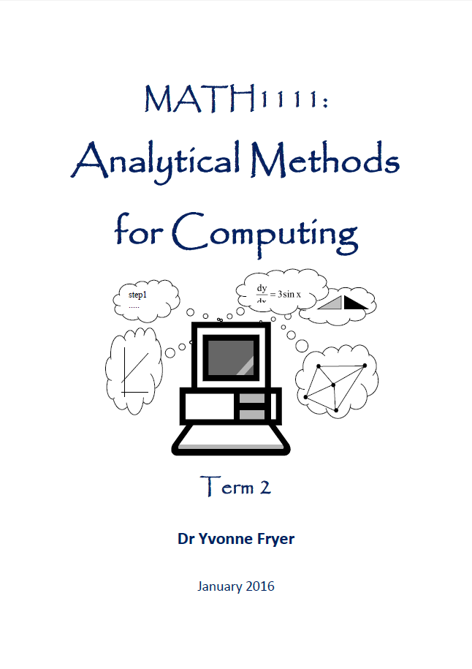
Analytical Methods for Computing
More stretching topics
Functions
Vectors
Matrices
Graph theory
Algorithms
Differentiation
Integration
Complex Numbers
Probability

Slide 4
To pass this course
YOU must make the effort to understand everything
ATTEND on time and regularly
ASK your tutor to explain any problems once you have tried the examples
COMPLETE all the tutorials on time
Bring A4 paper, pens, calculator for tutorials
REVISE all topics for the exam
DO your best

Slide 5
Tutorial-type submissions
4 or 5 parts to submit
* Functions * Matrices * Graph theory * Algorithms (* Calculus)
Counts as 50% of the course mark!!
no second attempts or late work handed in (unless ECs).
More information on the assignment coming soon on Teachmat and/or Moodle

Slide 6
Tutorial groups
Analytical Methods for Computing - Friday - Tutorial Groups
11-12pm | 12-1pm
5 – QA120 Yvonne Fryer | 7 – QA165 Babak Takand
2 – SL002 Joy Botu | 1 – SL002 Andrejs Tucs
3 – QA239 Ivana Nikolic | 8 – QA239 Mohammad Shajalal
4 – QA175 Sidra Athar | 6 – SL105 Veronica Pellacini
Check where you are meant to go … on your timetable.

Slide 7
Relations Mappings & Functions

Slide 8
Relations
Judy Tom Ben Errol Marsha Tanya

Slide 9
A subset of Parents x Children
Judy Tom Ben
Errol Marsha Tanya
Judy
Tom
Marsha
Ben
Errol
Tanya
Relation R
P = { Parents} =
{Judy,Tom,Marsha}
C= { Children} =
{Ben, Errol,Tanya}

Slide 10
Cartesian Product set
Parents X Children (all possible pairings)
P x C ={(p,c) : p ∈ P, c∈ C}=
{(Judy,Ben), (Judy,Errol), (Judy,Tanya),
(Tom,Ben), (Tom,Errol), (Tom,Tanya),
(Marsha,Ben), (Marsha,Errol), Marsha,Tanya)}
Relation R = {(Judy,Ben), (Tom,Ben), (Marsha,Errol), (Marsha,Tanya)}

Slide 11
Another example of a relation between the sets S and C. Since there
are elements in S associated with two different elements of C and some
elements in C associated with many elements in S it is called
Many to Many.
SIMINA
HELEN G23
JAWED G67
STEPHEN N45
AYSHA H43
JO
R = { (Simina, G67), (Helen, G67), (Jawed, G23), (Stephen, H43), (Aysha, G23), (Aysha, G67)}
SUBSET of S×C
S (Students)
C (Courses)
Relation R

Slide 12
Other types of relations
Many to one
One to one

Slide 13
What sort of relations are these?
Arsenal
Man Utd
Jo Smith
Uri Geller
Jo Smith
Uri Geller
O
AB
1:m
m:1
football clubs
loyal supporters
people
blood groups
Yvonne Fryer
Erwin George
Jim Smith
Uri Geller
Jo Smith
Eve Bond
Jo Smith
Ben Hur
1:1
m:m
husbands
wives
lecturers
students

Slide 14
Projection Mappings
Enable us to isolate one part of the pair in a relation
p₁ (Simina, G67) = Simina
So the projection isolates the 1st of the pair
p₂ (Stephen, H43) = H43
So the projection isolates the 2nd of the pair
p ₁ : A × B → A , p ₁ (a, b) = a,
p ₂ : A × B → B , p ₂ (a, b) = b
p₁
A
B
A×B
p₂

Slide 15
Database Queries
Name | Item
Jones | Mugs
Jones | Plates
Smith | Cups
Smith | Saucers
Smith | Plates
What has Smith ordered? Who wants Plates?
p₂ {(Smith,Cups) (Smith,Saucers) (Smith,Plates)}= {Cups,Saucers,Plates}
p ₁ {(Jones, Plates), (Smith,Plates)} = {Jones,Smith}

Slide 16
Name | Item
Jones | Mugs
Jones | Plates
Smith | Cups
Smith | Saucers
Smith | Plates
p ₁
p ₂
Mugs
Plates
Cups
Saucers
Jones
Smith
p ₁⁻¹
p ₂ ⁻¹
Relation

Slide 17
Relational Database
The database holds information on the relation(s)
Your query makes use of those relation(s)
The projection mappings work in two directions
p_{1 ,}p₂ start from the relation and picks a set
The inverses p₁⁻¹ , p₂⁻¹ start with a set and find the relations with that set
Name | Item
Jones | Mugs
Jones | Plates
Smith | Cups
Smith | Saucers
Smith | Plates
p ₁ {(Jones, Plates), (Smith,Plates)} = {Jones,Smith}
p ₁ ⁻¹ {Jones} = {(Jones,Mugs), (Jones,Plates)}
p ₂ {(Jones, Mugs), (Jones,Plates)} = {Mugs,Plates}
p ₂ ⁻¹ {Cups, Saucers} = {(Smith, Cups),(Smith, Saucers)}

Slide 18
Queries using relations
How do we express a query using these
What has Smith ordered?
We need to go from Smith to the pairs he is part of and then to the second elements of those pairs i.e.
Smith p ₁⁻¹ (Smith) p₂ (p ₁⁻¹ (Smith))
Similarly with
Who wants Plates?
Plates p ₂⁻¹ (Plates) p₁ (p ₂⁻¹ (Plates))

Slide 19
Note projections go from pairs to singles
inverse projections go from singles to pairs
p ₁
PAIRS
p ₂
p ₁⁻¹
p ₂ ⁻¹
First
Second
Relation

Slide 20
Drums
Keyboard
Guitar
Violin
Flute
Andy
Peter
Alex
Liz
Martin
M
I
The manager of a rock band wants to look at the skills of the musicians on the agency books. These are expressed in the form of a relation R = {(m,i) : m ∈ M, i∈ I where m can play i}
Write expressions to give him
The musicians who play drums
The instruments Peter plays
Write out the answers for each of these
p₁ o p ₂ ⁻¹ {Drums} p₂ o p ₁⁻¹ {Peter}
{Andy,Peter, Martin} {Drums,Keyboard,Guitar}

Slide 21
Mappings or Functions?
What colour car do they have?
Phil
Andy
Jo
Matt
Caitlin
Red
Blue
Yellow
White
Matt has no car
No-one has a white car
2 Sets Domain Codomain
This is a Mapping from people to colours (arrows go one way)

Slide 22
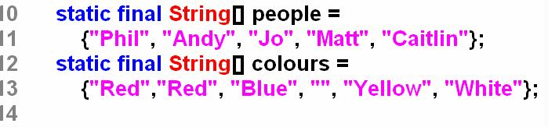

Phil
Andy
Jo
Matt
Caitlin
Red
Blue
Yellow
White
2 Sets Domain Codomain are like Inputs and Outputs

Slide 23
This is a Mapping from a set of Dads to their children
Domain = {men} Codomain = {children}
Mark
Sophie
Richard
Rhys
Caitlin
Hannah
John
David
Karl
Domain Codomain

Slide 24
Mapping from a group of friends to their partners
Nobody loves me!
☹
Domain = {people}
Codomain = {people}
These are mappings but NOT relations as the arrows only go one way (although it could)
These are mappings but NOT functions because functions have extra constraints.

Slide 25
Functions (special mappings)
Similar in idea to travel by train
London
Scunthorpe
Luton
Brighton
Edinburgh
Paris
John
Peter
Arif
Lisa
Misha
Karl
Loraine
Every passenger has a destination
Some destinations don’t have any visitors
No passenger goes to 2 destinations
Many visitors can go to the same place

Slide 26
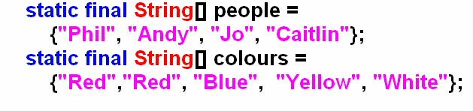
Phil
Andy
Jo
Caitlin
Red
Blue
Yellow
White
Now a function
as Matt has
been removed
Domain Codomain

Slide 27
Definition of a Function
Every element of the domain must be sent to an element in the co-domain.
Some elements of the co-domain may fail to have any element of the domain sent to them.
No element of the domain is sent to more than one element of the co-domain.
Elements of the co-domain may have more than one element of the domain sent to them
(In books this may be written in slightly more mathematical language including image sets)

Slide 28
Range
Range (or Image) is the set of all those elements in
co-domain linked to an element in the domain.
range
codomain
inputs
function
outputs
ran f

Slide 29
Java functions
When we refer to a Java function we usually mean a method which take a number of inputs and returns an output.
private static int triple(int n)
{
return 3*n;
}
n
tripleit
3*n
1
2
3
4
3
6
9
12

Slide 30
Notation- in LF we use letters
f is a function from set A to set B
f:A→B
If f sends a∈A to b∈B we call b the image of a
f:a→b or
f(a) = b
a
b
Domain A Codomain B

Slide 31
if f is our tripleit function
f is a function from set A to set B
where A = {1,2,3,4} B = {3,6,9,12}
f:a→b or f(a) = b so here f:2→6 or f(2) = 6
returns
inputs
2
6
Domain A Codomain B

Slide 32
Types of Function
Let f be a function from set A to set B
i.e. f:A→B
Domain A Codomain B
Domain A Codomain B
ONTO
INTO
f
codomain
range

Slide 33
Types of Function
Let f be a function from set A to set B
i.e. f:A→B
MANY-1
1-1
Domain A Codomain B
Domain A Codomain B

Slide 34
f:A→B, Is it a Function? Type? (give 2 answers INTO/ONTO & M-1/1-1)
1. A = world population B = world
people→places of birth
2. A = students here
B = their brothers and sisters
people→siblings
3. A = students here B = N
people→national insurance numbers
4. A = houses in Britain B = their occupants
houses→occupants
5. A = population in rented accommodation B = world population
tenants→landlords
6. A = popstars B = no 1 hits
popstars→no 1 hits
7. A = students here B = all colours
people→favourite colours
8. A = students here B = their dates of birth
people →dates of birth
9. A = N B = N
numbers→their factors
10. A = N B = N\{1}
prime numbers→their factors
1.INTO M-1
2.not
3.INTO 1-1
4.not
5.INTO M-1
6.not
7.INTO M-1
8.ONTO M-1
9.INTO M-1
10.not

Slide 35
Composition of Functions (like nested queries)
Consider the family
Ben= Mary
John= Anna Peter=Jane Marion
Mark Sam Betty David Sally

Slide 36
Ben= Mary
John= Anna Peter=Jane Marion
Mark Sam Betty David Sally
sp or ps?
Taking subsets of the family and functions p and s we can see
p: x
→
father of x s: x
→
sister of x
Mark
John
Sam
p
s
Marion
David
Peter
Mark
Betty
John
Sam
s
p
David
Sally
Peter

Slide 37
p(Mark) = John and s(John) = Marion
s(p(Mark))=Marion and we use s ο p (Mark) = Marion
We say s of p or s composition p
but p ο s (Mark) = p(s(Mark)) = p(Betty) = John

Slide 38
x,y
add
x+y
x,y
(x+y)²
square
square
x ²,y ²
see the difference when x = 2 and y = 5
Ans 49, 29
x² + y ²
add

Slide 39
p
p.q
q
(p.q)'
If p: He likes video games q : He is quiet
The order of the composition is the difference between
He doesn’t like video games or he is not quiet
He doesn’t like video games but he is quiet
p'
p
p'.q
q

Slide 40
Note the restricted domains and co-domains
range 1st ⊆ domain 2nd
inputs
outputs
domain g
domain f
f
g
ran f
ran g
x
f
f(x)
g
g(f(x))

Slide 41
Nesting/Composition
We use the same processes in Excel and Access
=IF(AND(B2 > 29,E2 > 29, F2 > 39),"Pass"," ")
This is a formula designed to put Pass in a column after checking cwk and exam marks (held in columns B and E) are 30 or more and the total mark (held in column F) is 40 or more
You compete the AND before evaluating the IF

Slide 42
Numerical example
f : N→N f : x→2x (doubles everything)
g : R→R where g : x→x+1 (adds 1 on)
You can’t form f o g because the range
of the first function is R and is not a
subset of N.
You can form g o f because the range
of f is contained in the domain of g.

Slide 43
N
f : N→N f : x→2x
g : R→R where g : x→x+1
f
N
This is g o f
And is OK
g
R
R
This is f o g
And is not possible
f cannot take in Real numbers
g
R
f

Slide 44
N
f : N→N f : x→2x
g : R→R where g : x→x+1
f
N
This is g o f
And is OK
g
R
g o f (3) =
g (f(3)) =
g (6) =
7
g o f (-7) =
Not possible as
-7 not in N
g o f (5) =
g (f(5)) =
g (10) =
11

Slide 45
Inverse Functions
The most useful button in Word is the
6
f (x)=x+2
8
f ⁻¹(x)=x-2
8
6

Slide 46
f
f⁻¹
Inverse functions
(We met this ideas in projection mappings)
Only possible in 1-1 andonto functions (BOTH properties)
Together the function and its inverse have no effect
f o f ⁻¹ = f ⁻¹o f = identity (do nothing)

Slide 47
for inverse must be 1-1
Paul
Anne
Ravi
Simon
If these arrows represent favourite fruits,
Who shall I give the apple to?
(Whose favourite fruit is the apple)

Slide 48
for inverse must be onto
Paul
Anne
Ravi
Simon
If these arrows represent favourite fruits
Who do I give the bananas to?
Whose favourite fruit is the banana?

Slide 49
inputs
outputs
f
dom f
= ran f ⁻¹
ran f =
dom f ⁻¹
f ⁻¹
outputs
inputs
f : R→R f : x→2x then f⁻¹: R→R f ⁻¹ : x→
f : R→R f : x→2x+1 then f⁻¹: R→R f⁻¹ : x→

Slide 50
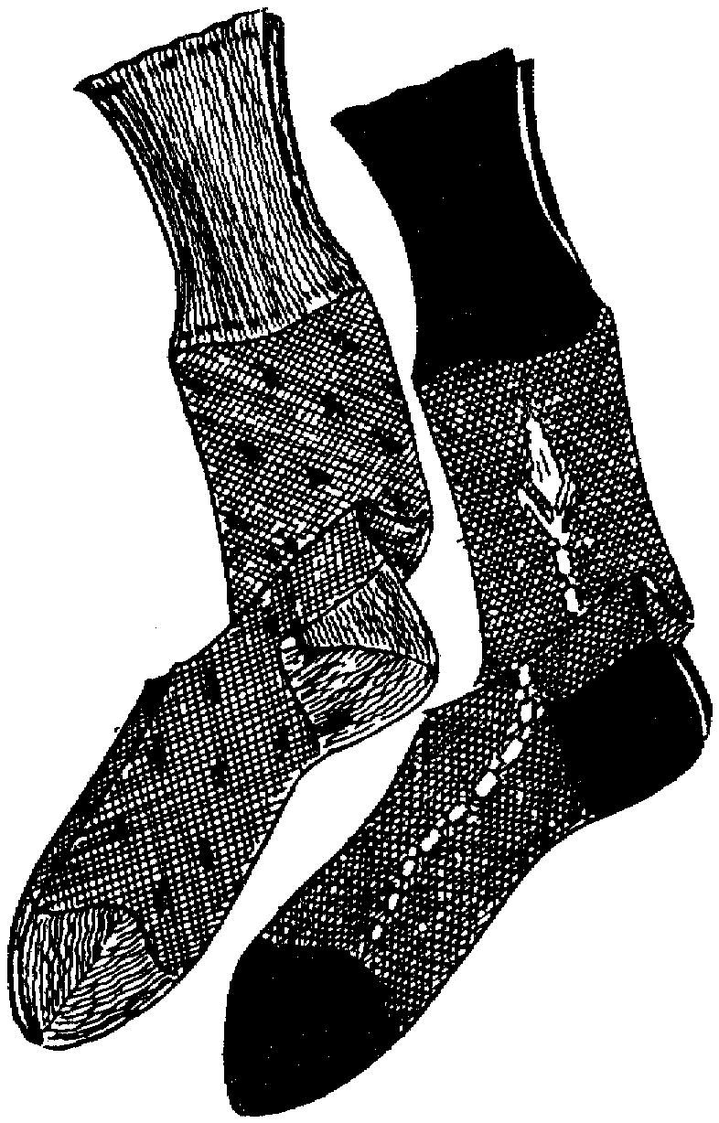
Reverse the order of operations

Slide 51
Dressing and undressing Reverse the order

Slide 52
Similarly for functions
x
f(x) = 2(x+3)
+3
x2
x
-3
+3
x+3
Inverse function
x
x2
2(x+3)
-3
x+3
x
/2
2(x+3)
f : x→2(x+3) then f ⁻¹ : x→ - 3

Slide 53
Tutorial groups
Analytical Methods for Computing - Friday - Tutorial Groups
11-12pm | 12-1pm
5 – QA120 Yvonne Fryer | 7 – QA165 Babak Takand
2 – SL002 Joy Botu | 1 – SL002 Andrejs Tucs
3 – QA239 Ivana Nikolic | 8 – QA239 Mohammad Shajalal
4 – QA175 Sidra Athar | 6 – SL105 Veronica Pellacini
Check where you are meant to go … on your timetable.

